Slide 1
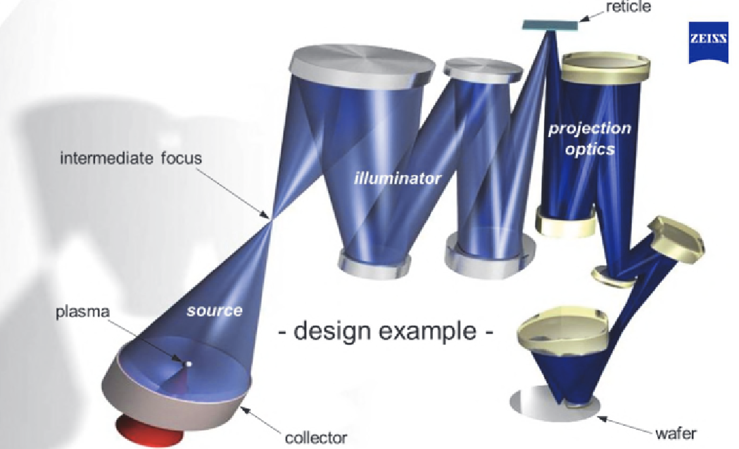
Application and Industry Adoption
important role in semiconductor industry
light source
imaging system
wafer (our goal)
[1] Schematic drawing of a Zeiss imaging system for EUV lithography
Notes:
[1] Erdmann, Andreas. Optical and EUV Lithography: A Modeling Perspective. SPIE--The International Society for Optical Engineering, 2021.

Slide 2



Application and Industry Adoption
How does it work? How does the end pattern get printed on the wafer?
[2] EUV light is generated from the source
Notes:
[2] TRUMPFtube: https://www.youtube.com/watch?v=NHSR6AHNiDs

Slide 3

Application and Industry Adoption
How does it work? How does the end pattern get printed on the wafer?
[3] Photons hit a multi-layer mirror called the collector
Notes:
[3] TRUMPFtube: https://www.youtube.com/watch?v=NHSR6AHNiDs

Slide 4

Application and Industry Adoption
How does it work? How does the end pattern get printed on the wafer?
[4] EUV light is shaped into a usable beam through additional optic
Notes:
[4] TRUMPFtube: https://www.youtube.com/watch?v=NHSR6AHNiDs

Slide 5

Application and Industry Adoption
How does it work? How does the end pattern get printed on the wafer?
[5] Pre-pulse laser hits the spherical tin droplet
Notes:
[5] TRUMPFtube: https://www.youtube.com/watch?v=NHSR6AHNiDs

Slide 6

Application and Industry Adoption
How does it work? How does the end pattern get printed on the wafer?
[6] Main pulse hits the tin droplet and vaporizes it (plasma)
Notes:
[6] TRUMPFtube: https://www.youtube.com/watch?v=NHSR6AHNiDs

Slide 7
Application and Industry Adoption
What are examples of companies operating in this industry?
In manufacturing Lithography Systems
[7] EUV lithography device
Notes:
[7] Canon Global: https://global.canon/en/technology/s_labo/light/003/09.html

Slide 8
Literature
Literature
From the Web
Dataset:
Centers for Disease Control and Prevention:
https://www.cdc.gov/brfss/annual_data/annual_data.htm
Kaggle Datasets:
https://www.kaggle.com/datasets/cdc/behavioral-risk-factor-surveillance-system
https://www.kaggle.com/datasets/alexteboul/diabetes-health-indicators-dataset
Material:
Statistical Learning with Python, Stanford Online
https://www.youtube.com/playlist?list=PLoROMvodv4rPP6braWoRt5UCXYZ71GZIQ
Python Libraries:
https://scikit-learn.org/
https://imbalanced-learn.org/stable/under_sampling.html
More on Random Forest:
https://www.geeksforgeeks.org/random-forest-algorithm-in-machine-learning/

